Slide 1

Modeling, Design, Analysis, and Control of a Spot Market for Hydrogen
An Application of Economic Circuit Theory
Pien van den Berkmortel 03-07-2024
Notes:
Today I’ll show you the potential of economic circuit theory for the modeling, design, analysis and control of a spot market for hydrogen

Slide 2

Hydrogen as Part of the Energy Transition
Context | Problem statement | ECT | Modeling & Design | Analysis | Control | Conclusions
Notes:
The energy landscape is undergoing a transformative shift towards a zero-emission future.
As hydrogen has the potential to decarbonize industrial operations, the Dutch government is actively developing a hydrogen economy [1].
To make this economy future prove, the supply of renewable hydrogen needs to be increased. Therefore, investments are needed in projects like the Holland Hydrogen I in Rotterdam (POINT), where renewable hydrogen is produced through electrolysis using wind energy.

Slide 3



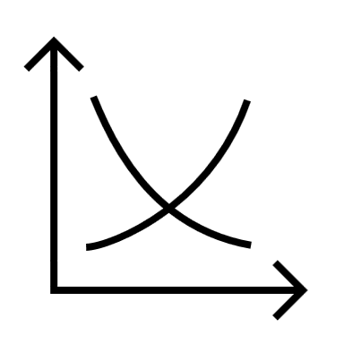



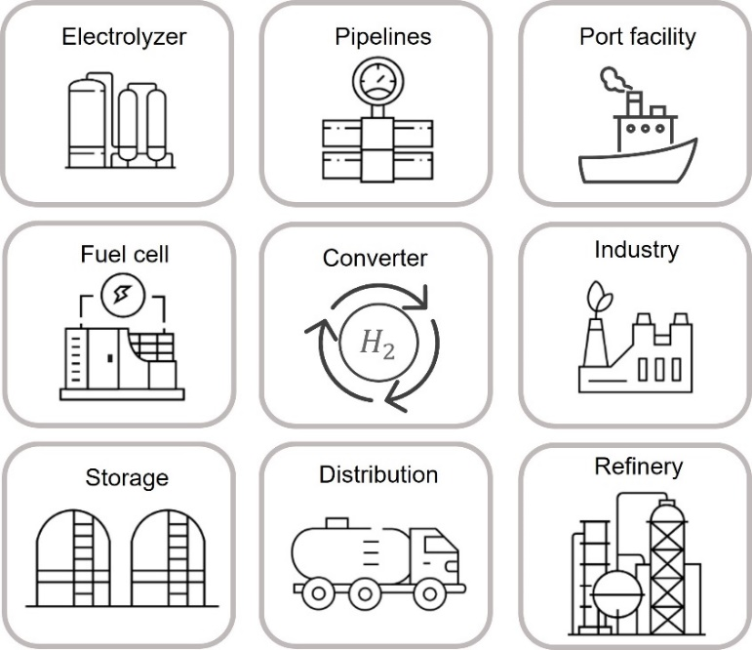
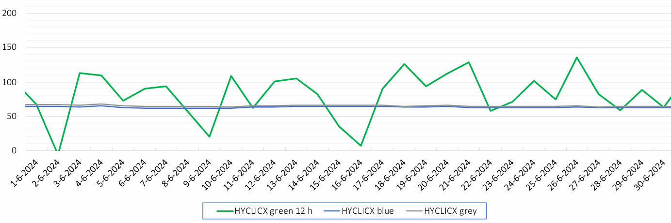
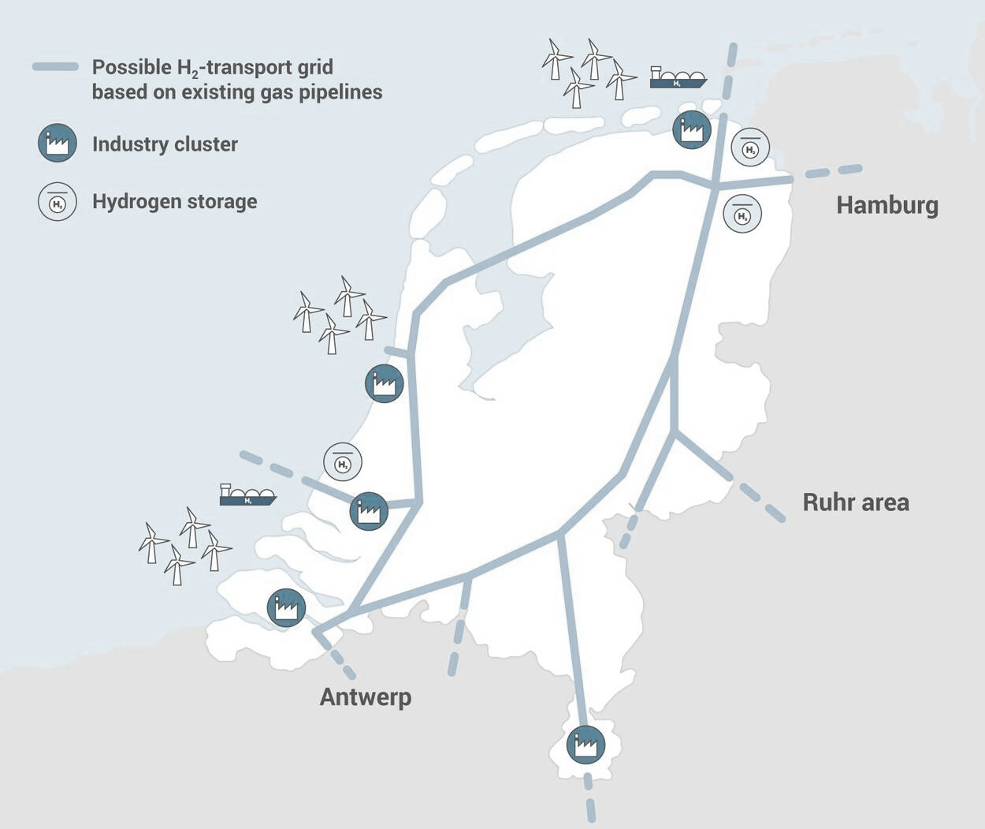
From Cost-Plus to Supply-and-Demand-Driven Pricing
Future market:
A spot market
Dynamic hydrogen price
Real-time balancing of supply and demand
Current market:
Long-term contracts
Fixed hydrogen price
Predictable revenue streams
€
€
Problem:
Integration of renewable hydrogen
Problem:
Unpredictable revenue streams
Increased volatility in hydrogen supply and prices
€/MWh
[3]
Context | Problem statement | ECT | Modeling & Design | Analysis | Control | Conclusions
Notes:
The current hydrogen market is dominated by locally produced hydrogen from natural gas. This H2 traded through long-term contracts with fixed hydrogen prices determined by marginal-cost-plus pricing and fixed supply agreements. → to ensure predictable revenue streams for hydrogen projects --CLICK--
However, this market is not suitable for increased integration of intermittent renwable hydrogen as supply and prices are difficult to determine (FIGURE)
--CLICK--
To integrate RH2, market experts envision a spot market. In such a spot market, prices become dynamic as they react to fluctuations in supply, demand, and storage levels. supply and demand are balanced in real-time (FIGURE)
--CLICK— These dynamic prices lead to considerable uncertainty for hydrogen projects, as revenue streams are no longer predictable. But also to increased volatility in supply and hydrogen prices

Slide 4





Economic Circuit Theory for Spot Market Modeling
Analysis:
Address unpredictability
Energy prices, storage levels, and energy flows
Dynamic resilience [6]
Modeling and Design:
Supply-and-demand-driven pricing
Modular framework
€
Price effects [4]
Spot market design [5]
[6] UNECE, “Building Resilient Energy Systems.” 2023.
Control:
Minimize volatility
Regulatory intervention [7]
[4] B. Koirala, et. al, “Integrated electricity, hydrogen and methane system modelling framework: Application to the Dutch Infrastructure Outlook 2050,” Applied Energy, 2021. [5] IRENA, “Making the breakthrough: Green hydrogen policies and technology costs,” International Renewable Energy Agency, 2021.
[7] Roland Berger, “Making the Hydrogen Market: Requirements for the Netherlands to become a hydrogen hub,” tech. rep., 2022.
$H_{2}$
Context | Problem statement | ECT | Modeling & Design | Analysis | Control | Conclusions
Notes:
I’ll demonstrate how economic circuit addressing these problems as allow us to build economic network models that explicitly incorporate this supply-and-demand-driven pricing mechanism. --CLICK—
I’ll also demonstrate how we can incorporate the price effects between coupled energy markets and how prices mutually affect energy market dynamics. --CLICK— we can also ECT as a tool for hydrogen market design, f.e. we can add an ammonia market (this is treated in more detail in my thesis)
--CLICK—
We van address the unpredictability of the spot prices through dynamic scenario analyses, a technique within ECT.
We show that we can explicitely derive the time evolution of energy prices, storage levels, and energy flows.
From which we quantify the market’s dynamic resilience againts shocks, which is an very important aspect of energy systems.
--CLICK—
We show that we can minimize volatiliy by implementing regulatory intervention as a controller.____________________________________________

Slide 5
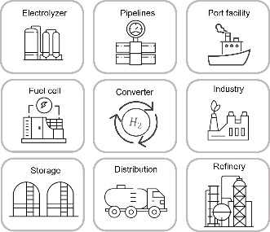


The Backbone as a Blueprint for Electrical Networks
Import by ship
Wind farm
Import by pipe
$${HA}_{2}$$
Renewable hydrogen production
€
Low-carbon hydrogen production
Market operator
Central hydrogen storage
$${HA}_{2}$$
Industrial demand
Local hydrogen storage
Context | Problem statement | ECT | Modeling & Design | Analysis | Control | Conclusions
Notes:
A spot market for hydrogen will operate on the hydrogen backbone, this backbone functions as the blueprint for our economic networks. The backbon will physically connect the five largest industry clusters in the Netherlands. This figure shows how different market agents that are connected to the infrastructure. Including different suppliers, connected wind farms, industrial demanders and storages I’ve been to TNO, and they use this network to determine the distribution of hydrogen throughout the hydrogen backbone. However, they do not recognize that this network can also be used to determine the economics of the hydrogen spot market.
--CLICK-- Within ECT, we use the node structure to determine the distribution of hydrogen.
--CLICK--
And we introduce a new mesh structure that allows us to build the hydrogen market economics into our models. This structure is visualized as suppliers and demanders that communicate their incentives to the market operator, which in turn matches supply and demand by adjusting the spot price.
Exploiting these structures, we our going to look at this network as an electrical circuit

Slide 6
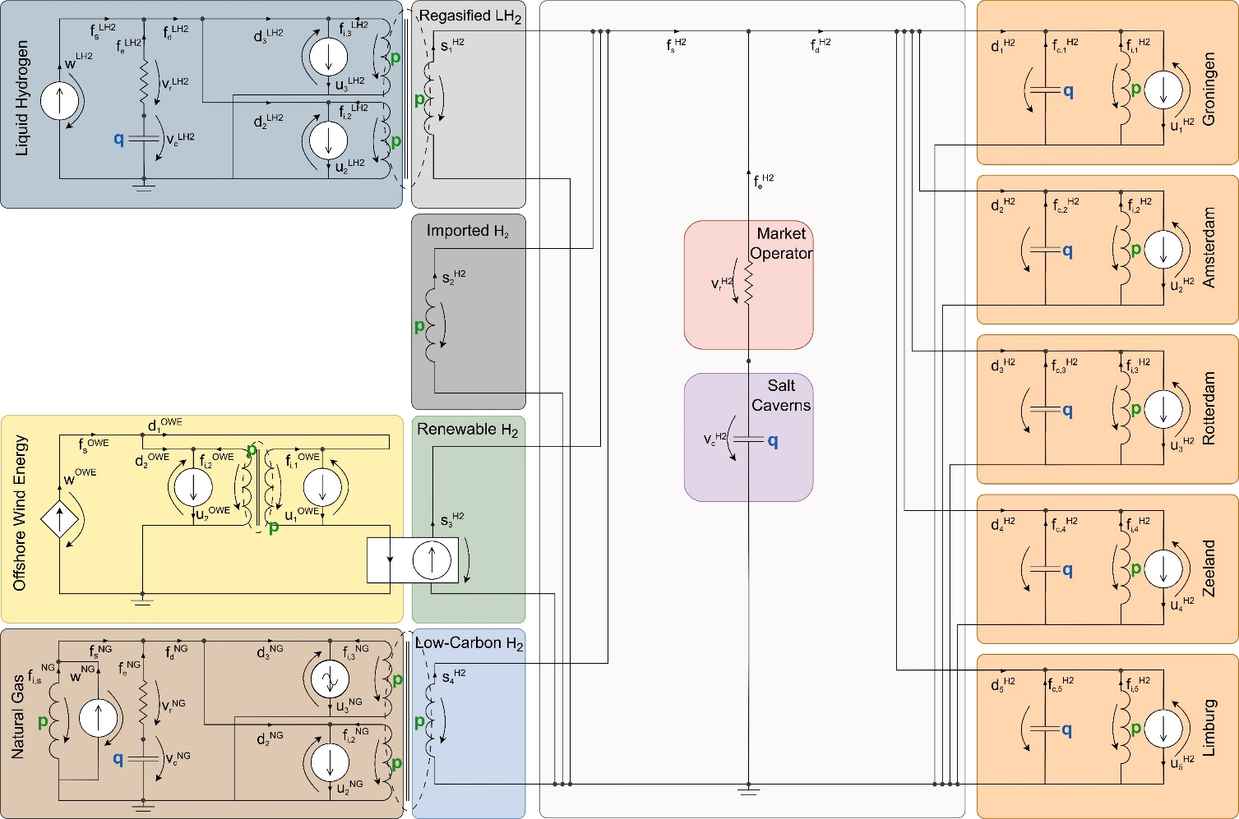
A Hydrogen Spot Market as an Electrical Network
Import by ship
Wind farm
Import by pipe
Renewable hydrogen production
Low-carbon hydrogen production
Market operator
Central hydrogen storage
$${HA}_{2}$$
$${HA}_{2}$$
Industrial demand
Local hydrogen storage
Context | Problem statement | ECT | Modeling & Design | Analysis | Control | Conclusions
Notes:
Here do you see such an electrical network of a hydrogen spot market. This network reflects both the flow of hydrogen through the backbone and the balancing of incentives among the market agents.
We model market agents as analogous electrical components.
--CLICK—
Here you can recognize the market agents We incorporate four hydrogen supply chains, indicated on the left. –CLICK-- We couple a natural gas market and a liquid hydrogen market through mutual inductance, which emulates the price effects between the markets.
On the right industry clusters –CLICK-- Here and here, we have the supply and demand (POINT), this is where we can measure the hydrogen spot price
(POINT) At this node hydrogen supply and demand come together. Any excess flow is brokered by the market operator and stored or extracted from the salt caverns. --CLICK-- This is where the hydrogen is storage (POINT) , and where we can measure the storage level --CLICK– This is the market operator (POINT) who couples the storage to the rest of the market and acts as a form of market friction
--CLICK-- Here we have the generated offshore wind energy, which is regulated (POINT)

Slide 7
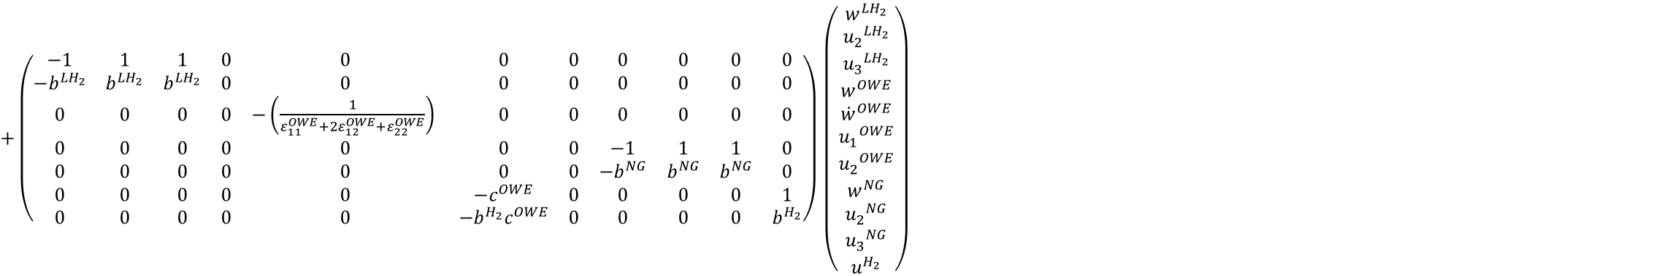
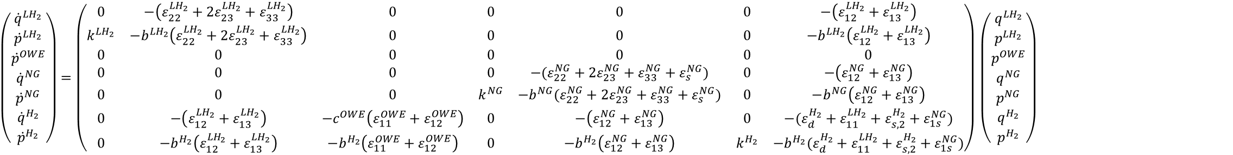
The Dynamics of Energy Prices and Storage Levels
$\left(\begin{matrix}{\dot{q}}^{{LH}_{2}} \\ {\dot{p}}^{{LH}_{2}} \\ {\dot{p}}^{OWE} \\ {\dot{q}}^{NG} \\ {\dot{p}}^{NG} \\ {\dot{q}}^{H_{2}} \\ {\dot{p}}^{H_{2}}\end{matrix}\right)=\left(\begin{matrix}0 & −\left(ε_{22}^{{LH}_{2}}+{2ε}_{23}^{{LH}_{2}}+ε_{33}^{{LH}_{2}}\right) & 0 & 0 & 0 & 0 & −\left(ε_{12}^{{LH}_{2}}+ε_{13}^{{LH}_{2}}\right) \\ k^{{LH}_{2}} & −b^{{LH}_{2}}\left(ε_{22}^{{LH}_{2}}+{2ε}_{23}^{{LH}_{2}}+ε_{33}^{{LH}_{2}}\right) & 0 & 0 & 0 & 0 & −b^{{LH}_{2}}\left(ε_{12}^{{LH}_{2}}+ε_{13}^{{LH}_{2}}\right) \\ 0 & 0 & 0 & 0 & 0 & 0 & 0 \\ 0 & 0 & 0 & 0 & −(ε_{22}^{NG}+{2ε}_{23}^{NG}+ε_{33}^{NG}+ε_{s}^{NG}) & 0 & −\left(ε_{12}^{NG}+ε_{13}^{NG}\right) \\ 0 & 0 & 0 & k^{NG} & −b^{NG}(ε_{22}^{NG}+{2ε}_{23}^{NG}+ε_{33}^{NG}+ε_{s}^{NG}) & 0 & −b^{NG}\left(ε_{12}^{NG}+ε_{13}^{NG}\right) \\ 0 & −\left(ε_{12}^{{LH}_{2}}+ε_{13}^{{LH}_{2}}\right) & −c^{OWE}\left(ε_{11}^{OWE}+ε_{12}^{OWE}\right) & 0 & −\left(ε_{12}^{NG}+ε_{13}^{NG}\right) & 0 & −(ε_{d}^{H_{2}}+ε_{11}^{{LH}_{2}}+ε_{s,2}^{H_{2}}+ε_{1s}^{NG}) \\ 0 & −b^{H_{2}}\left(ε_{12}^{{LH}_{2}}+ε_{13}^{{LH}_{2}}\right) & −b^{H_{2}}\left(ε_{11}^{OWE}+ε_{12}^{OWE}\right) & 0 & −b^{H_{2}}\left(ε_{12}^{NG}+ε_{13}^{NG}\right) & k^{H_{2}} & −b^{H_{2}}(ε_{d}^{H_{2}}+ε_{11}^{{LH}_{2}}+ε_{s,2}^{H_{2}}+ε_{1s}^{NG})\end{matrix}\right)$ $\left(\begin{matrix}q^{{LH}_{2}} \\ p^{{LH}_{2}} \\ p^{OWE} \\ q^{NG} \\ p^{NG} \\ q^{H_{2}} \\ p^{H_{2}}\end{matrix}\right)$
$+\left(\begin{matrix}−1 & 1 & 1 & 0 & 0 & 0 & 0 & 0 & 0 & 0 & 0 \\ −b^{{LH}_{2}} & b^{{LH}_{2}} & b^{{LH}_{2}} & 0 & 0 & 0 & 0 & 0 & 0 & 0 & 0 \\ 0 & 0 & 0 & 0 & −\left(\frac{1}{ε_{11}^{OWE}+2ε_{12}^{OWE}+ε_{22}^{OWE}}\right) & 0 & 0 & 0 & 0 & 0 & 0 \\ 0 & 0 & 0 & 0 & 0 & 0 & 0 & −1 & 1 & 1 & 0 \\ 0 & 0 & 0 & 0 & 0 & 0 & 0 & −b^{NG} & b^{NG} & b^{NG} & 0 \\ 0 & 0 & 0 & 0 & 0 & −c^{OWE} & 0 & 0 & 0 & 0 & 1 \\ 0 & 0 & 0 & 0 & 0 & −b^{H_{2}}c^{OWE} & 0 & 0 & 0 & 0 & b^{H_{2}}\end{matrix}\right)$ $\left(\begin{matrix}w^{{LH}_{2}} \\ {u_{2}}^{{LH}_{2}} \\ {u_{3}}^{{LH}_{2}} \\ w^{OWE} \\ {\dot{w}}^{OWE} \\ {u_{1}}^{OWE} \\ {u_{2}}^{OWE} \\ w^{NG} \\ {u_{2}}^{NG} \\ {u_{3}}^{NG} \\ u^{H_{2}}\end{matrix}\right)$
Context | Problem statement | ECT | Modeling & Design | Analysis | Control | Conclusions
Notes:
From this network, we derive the dynamics of energy prices and storage levels using the node and mesh law inherent in economic circuit theory --CLICK node structure --CLICK--Here you see two meshes, together with the other meshes they form the mesh structure, reflecting the market economics
--CLICK— we analytically derive a state space representation that describes the dynamics of the energy prices and storage levels
Our state space consists of an state matrix and an input matrix.
I’ve organized the matrices such that you can recognize the four energy markets;
--CLICK—
The diagonal blocks show the Internal market dynamics
(POINT) In the STATE Diagonal the influence of the prices on the price dynamics
On the diagonal entries show that the storage level and price in each market is coupled.
In the INPUT We see that the inelastic supply and demand influence both th storage level and energy price in the market.
POINT)Here we see that the OWE prices are only determined by the offshore wind energy generation
--CLICK— The off diagonal blocks show the influence of markets on each other.
Here you see that markets are coupled only through their energy prices.
--CLICK—
So when we look at the hydrogen price dynamics, we see that it is influenced by the energy prices of liquid hydrogen, offshore wind energy and natural gas and also by the rate of change in wind energy generation
We can thus precicely predict the hyrdogen price over time

Slide 8
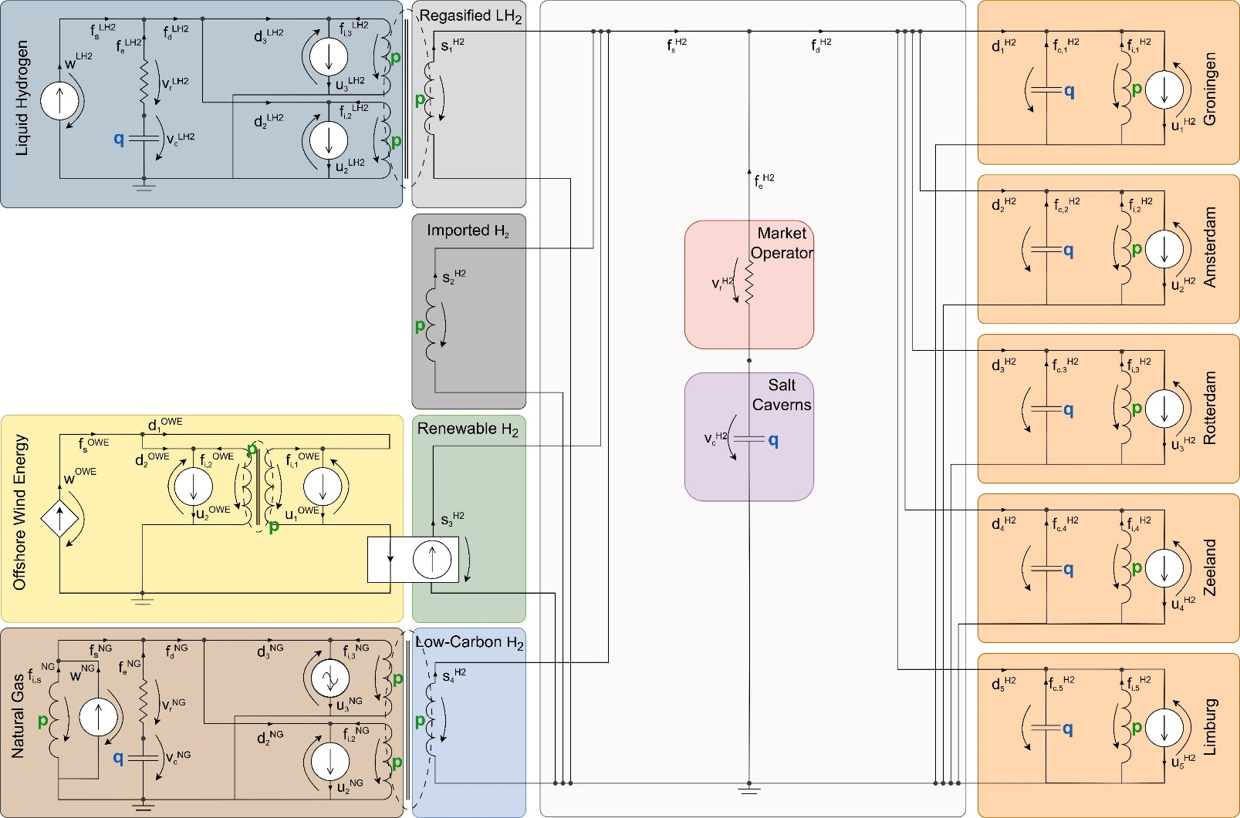
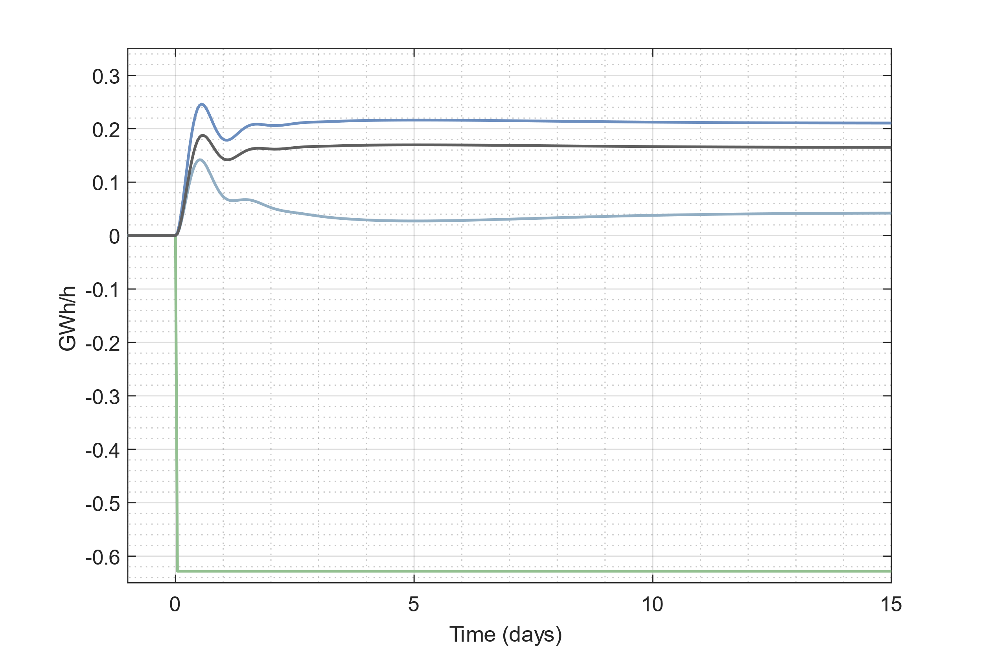
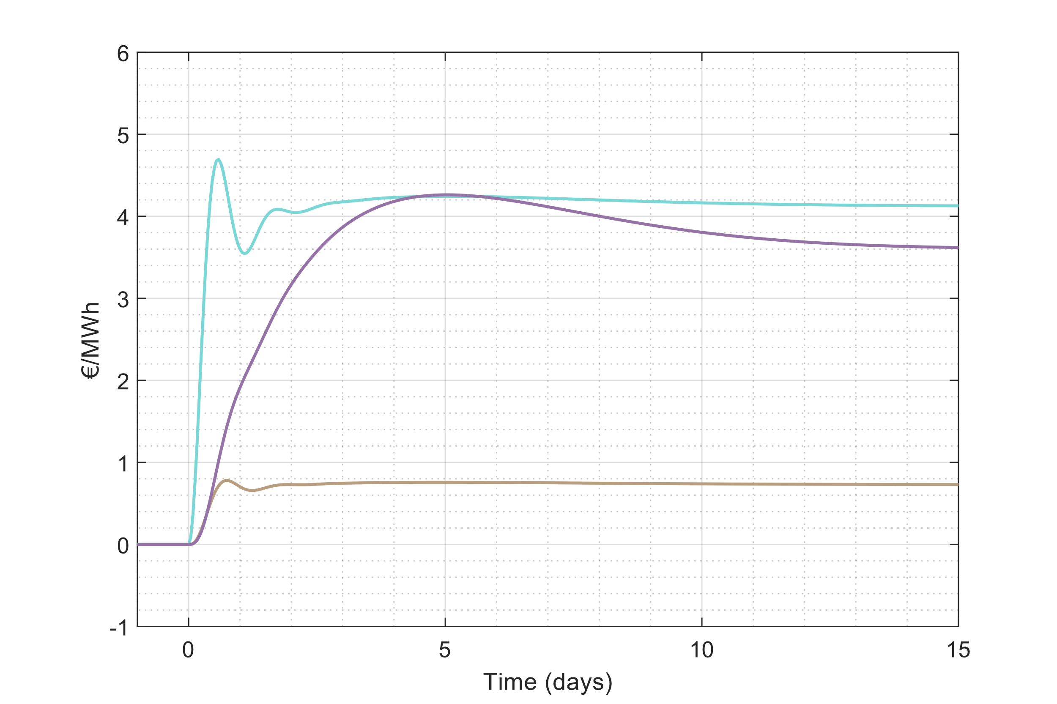
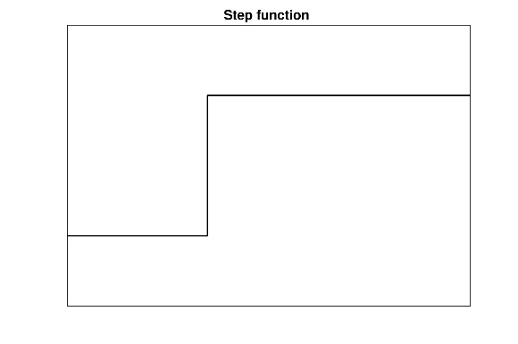
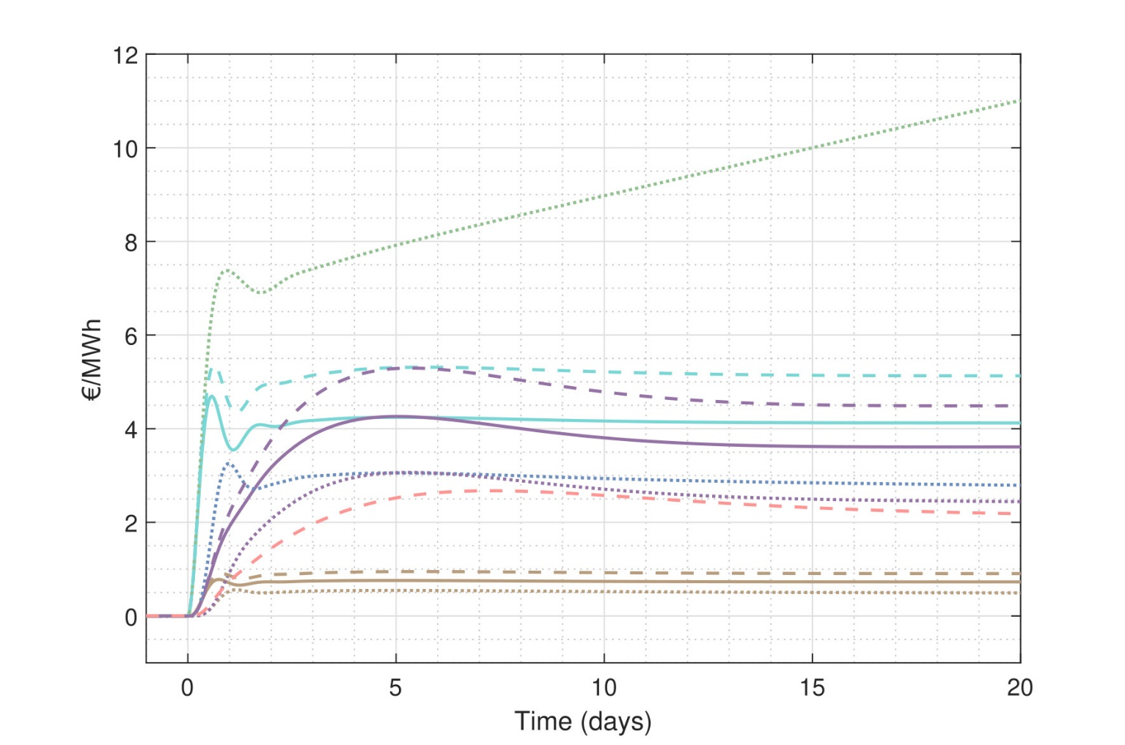
Dynamic Scenario Analysis: Dynamic Resilience
A
Hydrogen supply
Energy prices
V
A
V
A
A
V
Renewable
Low-carbon
Imported H2
Regasified H2
Hydrogen (all)
Liquid hydrogen
Natural gas
Context | Problem statement | ECT | Modeling & Design | Analysis | Control | Conclusions
Notes:
We can also analyze and quantify the dynamic resilience of the hydrogen market after an OWE shock
--CLICK-- Such a shock can represent a dunkelflaute (no wind) or wind park is shut of due to maintenance.
--CLICK-- Than we can measure the hydrogen supply through the different supply chains here --CLICK—And the hydrogen prices are measured here
--CLICK—From our measurements, we get the time evolution of hydrogen flows and energy prices.
--CLICK—On the left we see the volatility and recovery of hydrogen flows. On the right we see that the wind shock generates a demped ripple effect that impacts the dynamics across the coupled commodity markets.
So what do we see here.
1) The OWE shock directly impacts the supply of renewable hydrogen, here in green. 2) This results in an imbalance, wich in turn leads to hydrogen prices to increase
3) Through price coupling, prices in coupled markets increase and t, hydrogen supply chains increase their production
4) LH2 prices are more rigid due to lower price elasticities
5) By comparing the supply chains, we see that the low-carbon hydrogen supply chain is most-price elastic, while regasified liquid hydrogen only functions as a short term flexibility mechanism

Slide 9
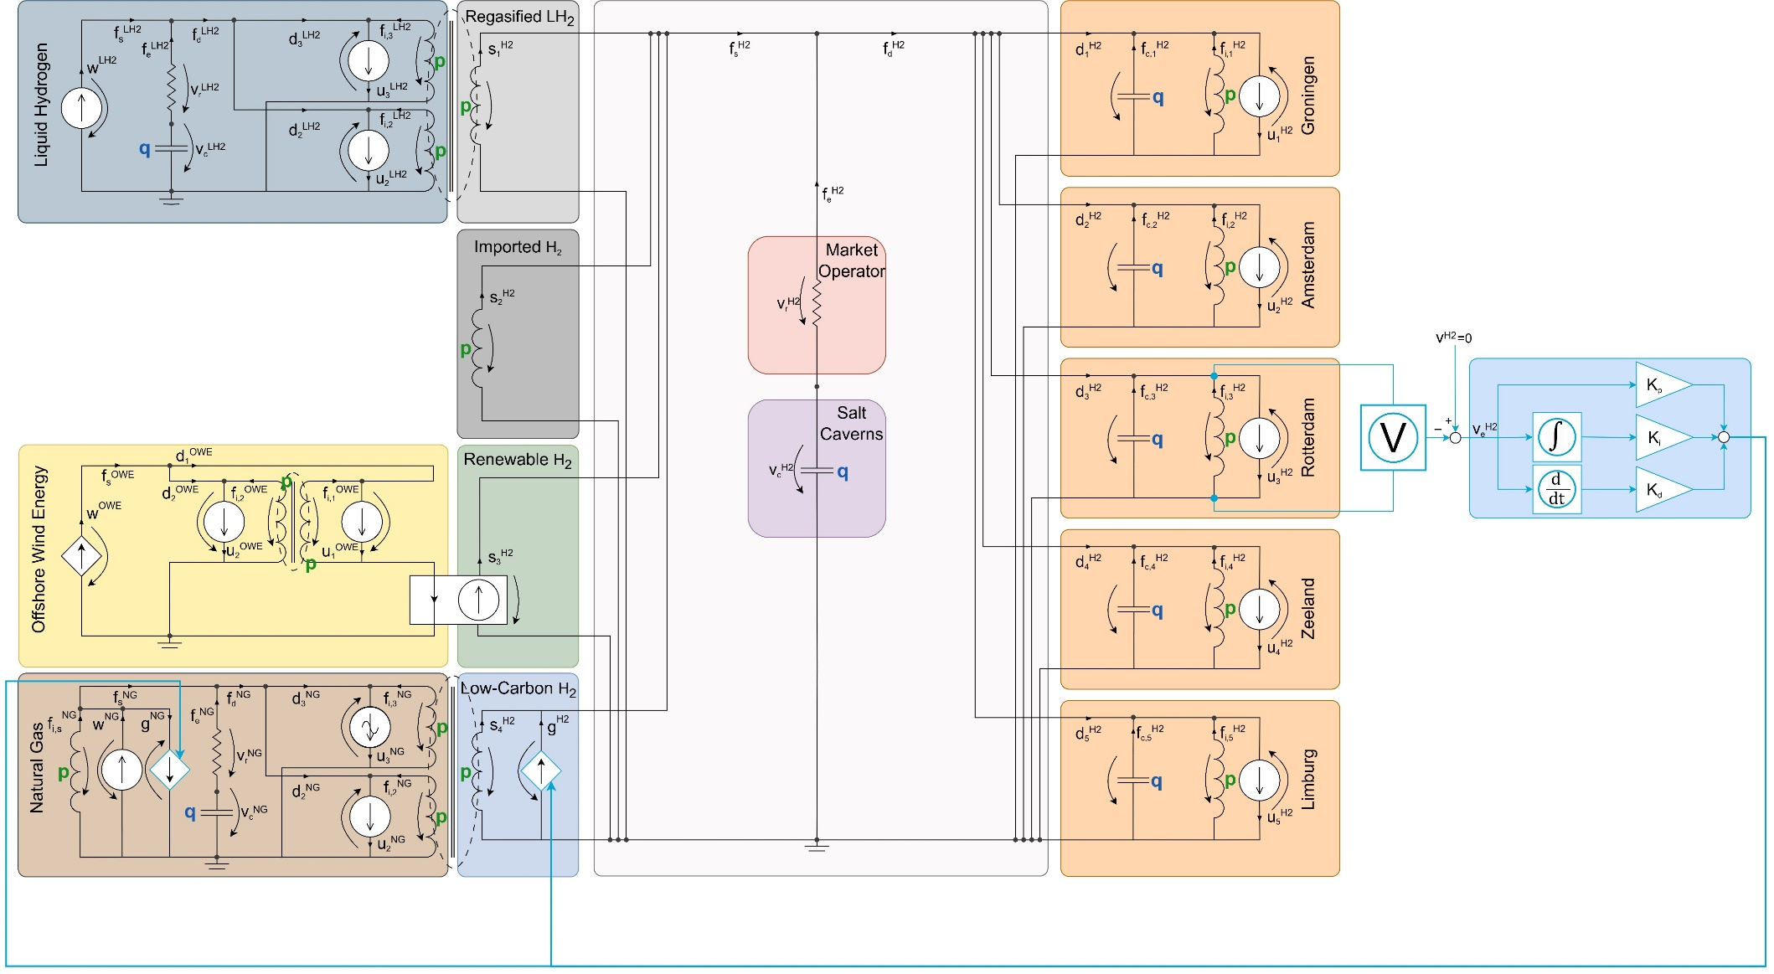
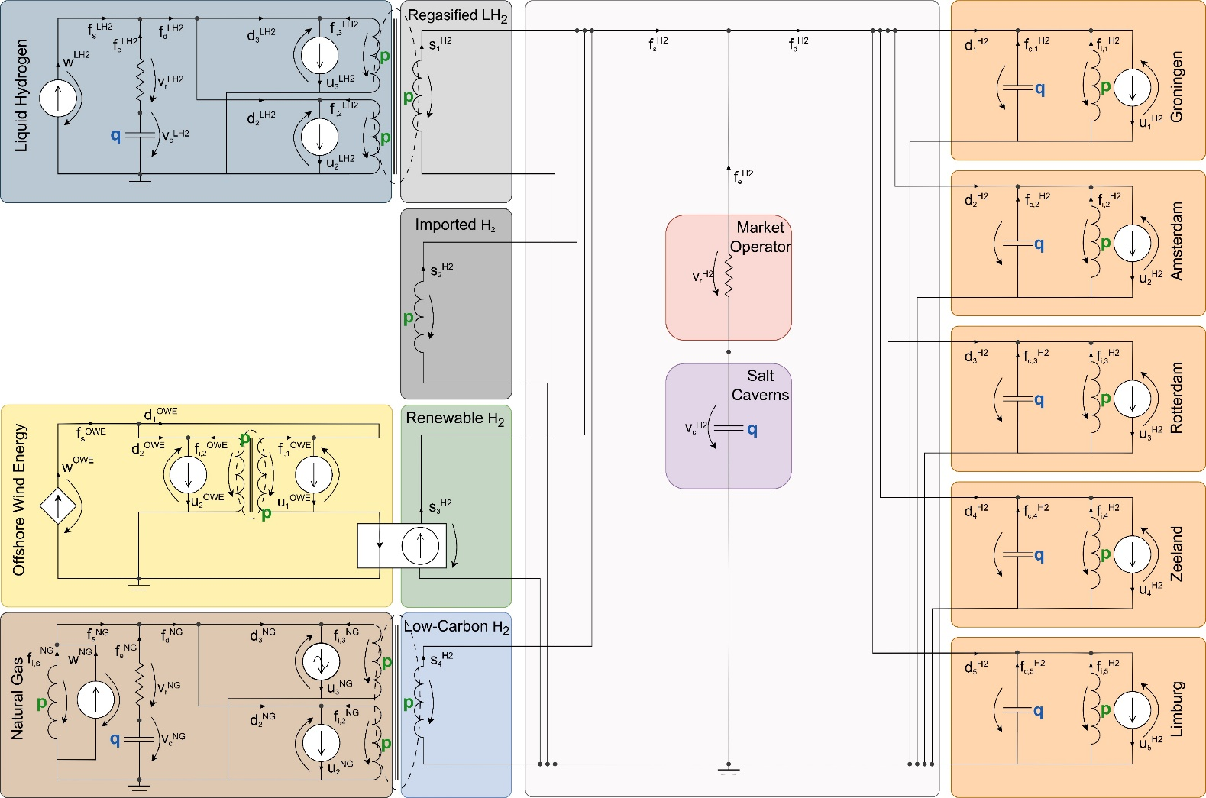
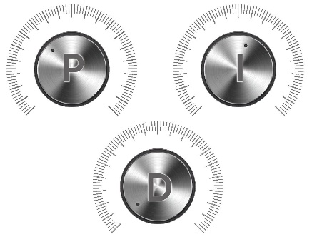
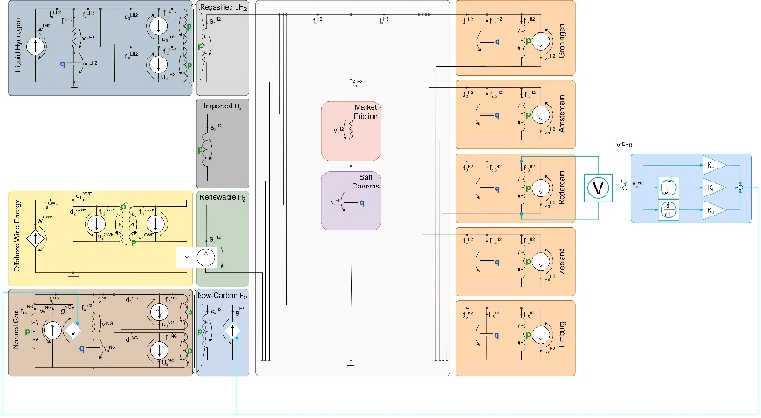


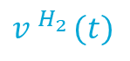
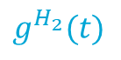
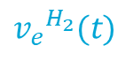
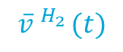
Regulatory Intervention as a PID Controller to Minimize Volatility
Proportional
$$\overline{v}.^{H_{2}}(t)$$
$${v_{e}}^{H_{2}}(t)$$
$$g^{H_{2}}(t)$$
Regulatory agent
Regulatory agent
$$v.^{H_{2}}(t)$$
_
Integral
Derivative
Context | Problem statement | ECT | Modeling & Design | Analysis | Control | Conclusions
Notes:
Now you’ve seen the volatility, we can also design regulatory intervention to minimize this volatility. F.e., with a budget of 10M we can design a subsidy scheme that uses subsidized low-carbon hydrogen production as a flexibility mechanism.
Our goal is to design a realistic controller that minimizes volatility while meeting this budget. We choose a PID controller as the control actions are economically interpretable
`--CLICK--
This is how we implement the regulatory agent. To determine the subsidized low-carbon hydrogen production, we measure (POINT) the market incentives in real-time and compare them to the reference incentive to generate a real-time error signal. This error signal quantifies the deviation from the control objective. Based on this error signal, the regulator influences low-carbon hydrogen production (POINT) in order to reject the disturbance.
--CLICK— --CLICK--
The subsidized low-carbon hydrogen production is a sum of three control actions, a proportional, integral and derivative action. Imagine it as three knobs with which you can tune its performance
- The P action relates the error incentive directly to a flow. This acts as additional market friction. By increasing the control gain, we decrease the price volatility
- The I action accumulates the error incentives into a price. Which is then related to a flow of low-carbon hyrogen. This control action acts as an elementary supplier. By increasing the control gain, we increase the subsidezed low-carbon hydrogen production.
- By adding a D action, the regulatory agents anticipates on future incentives by looking at the acceleration of the error incentives.

Slide 10
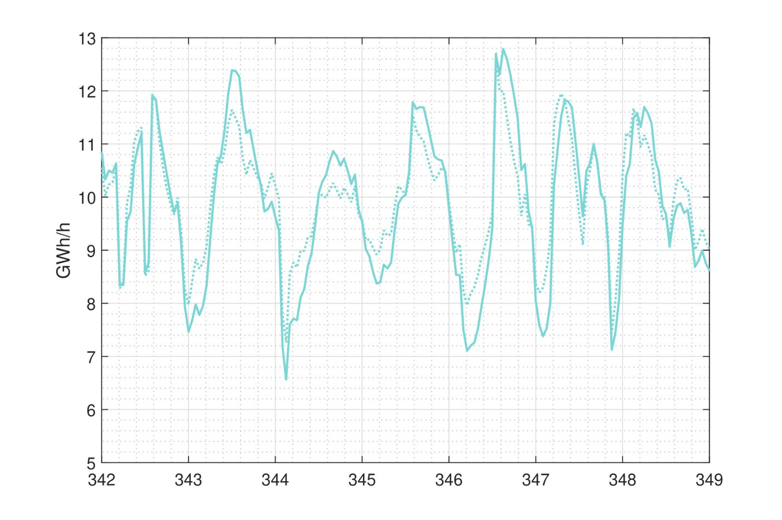
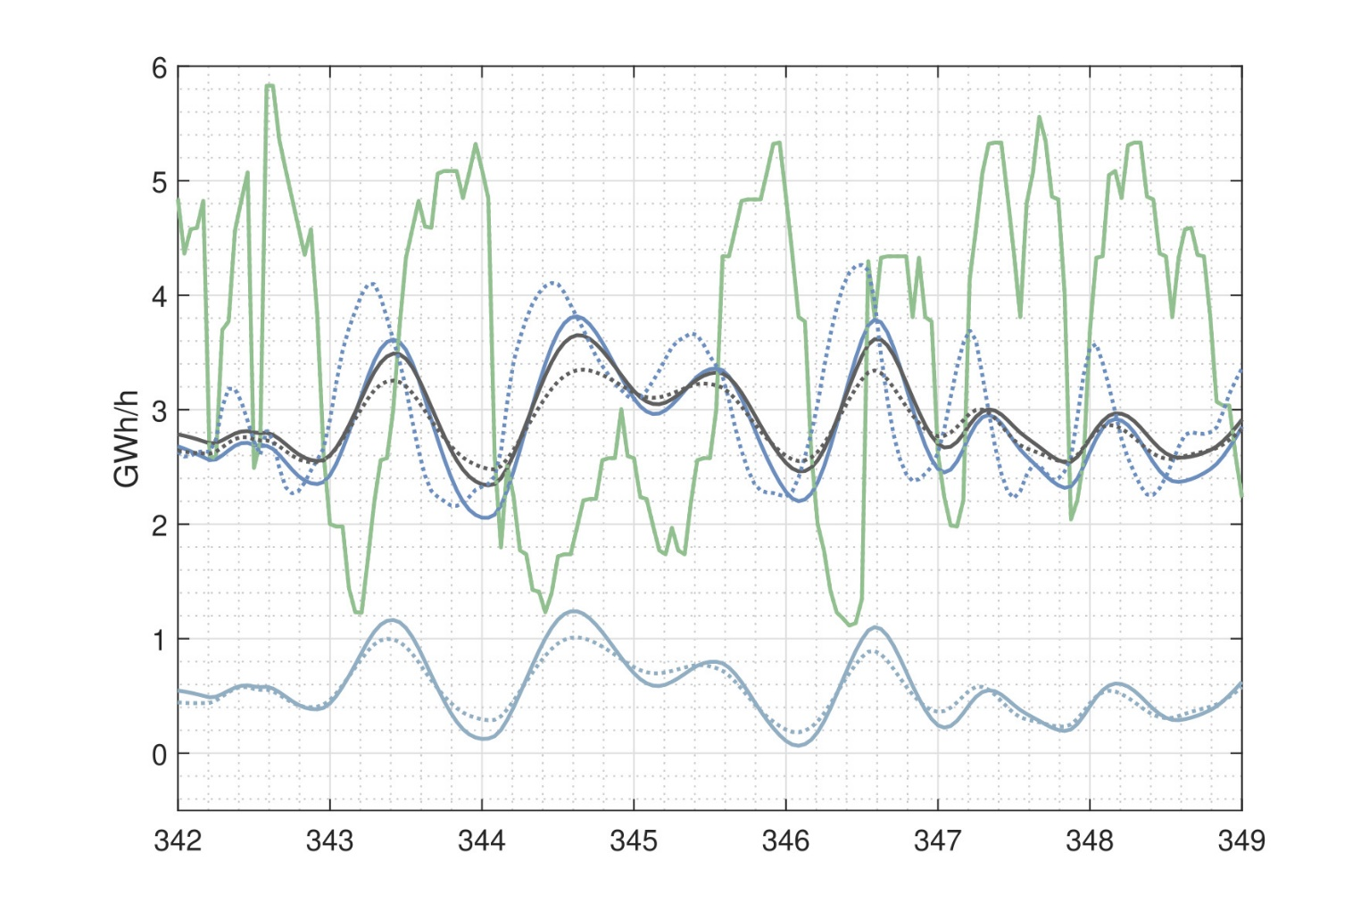
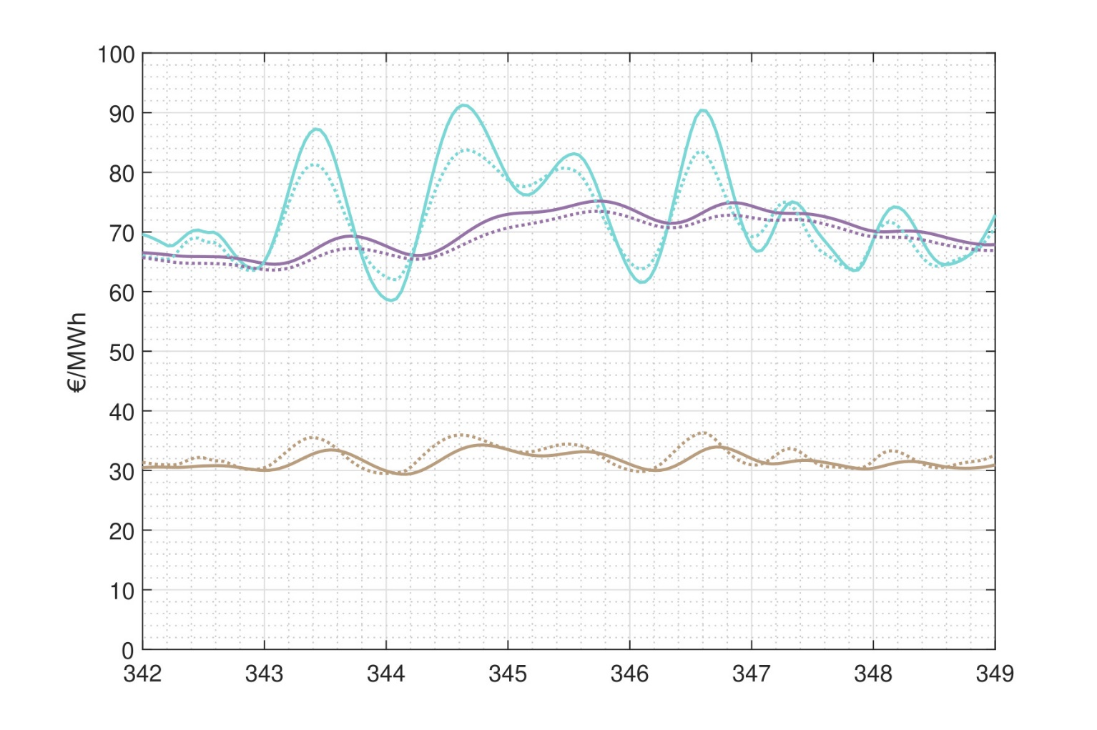
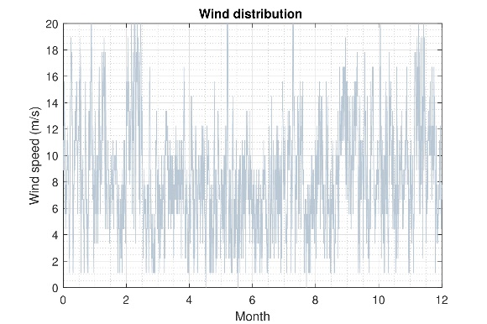
Dynamic Scenario Analysis: Regulatory Intervention
A
Hydrogen supply
Energy prices
Total hydrogen supply
Subsidy effects:
Hydrogen price - 2.1 %
Hydrogen supply + 0.9 %
Natural gas price + 3.3 %
Subsidy costs:
Total 9.3 M€
Percentage of total trade 3.3 %
Uncontrolled
V
Controlled
A
A
[4] B. Koirala, et. al, “Integrated electricity, hydrogen and methane system modelling framework: Application to the Dutch Infrastructure Outlook 2050,” Applied Energy, 2021. [5] IRENA, “Making the breakthrough: Green hydrogen policies and technology costs,” International Renewable Energy Agency, 2021.
A
V
Renewable
Low-carbon
Imported H2
Regasified H2
Hydrogen (all)
Liquid hydrogen
Natural gas
Context | Problem statement | ECT | Modeling & Design | Analysis | Control | Conclusions
Notes:
We demonstrate the effectiveness of the regulatory intervention through dynamic scenario analysis
--CLICK—
Herefore we use a wind sequence as an input of the network
--CLICK—
And again we’re going to measure the prices and the hydrogen flows through the different supply chains
--CLICK—
We look at a period with high volatility in renewable hydrogen supply The low-carbon hydrogen production starts adapting earlier to price changes to the subsidy. (DOTTED) This leads to lower H2 price volatility, resulting in lower hydrogen supply volatility through the other supply chains
Natural gas prices slightly increase due to the increased demand for hydrogen production.
--CLICK—
The subsidy schemes thus leads to lower supply volatility, and lower hydrogen price volatility. Which we can quantify precisely
This can be done with a subsidy costs of only 9M, image what you can dow with more

Slide 11
Conclusions
A proof of concept of economic circuit theory:
Make revenue streams predictable
Quantify and minimize volatility
State-space representation
Network extensions using a port-based approach [8]
Seasonality in prices and storage levels
Optimizing wind-hydrogen production using MPC
Taking this work further:
Profitability
Further minimize volatility
[8] C. Hutters and M. Mendel, “A Multiport Network Framework for Dynamic Agent-Based Economic Modeling (Preprint),” 2024.
Context | Problem statement | ECT | Modeling & Design | Analysis | Control | Conclusions
Notes:
This thesis serves as a proof of concept for the application of economic circuit theory in effectively addressing supply-and-demand-driven pricing in a hypothetical spot market for hydrogen. - We’ve demonstrated that with our models, we can make revenue streams predictable → support investment decicisons for hydrogen projects
- Shown we can quantity volatility using dynamic resilience analysis - AND also minimize volatility through regulatory intervention such as a subsidy scheme
- THEREBY we address the two critical problems of a spot market for hyrdogen
- We’ve derived a state space representation. Which can be used in further research for system identification and controller design.
--CLICK—
As this is still a prototype, this work can be taken much further. We can add extensions to our models and by exploiting the port-based approach within economic circuit theory we can design more complex market agents. This approach particularly lends itself to extending our analysis to the Laplace domain, using bode plots and pole-zero maps that provide us with insights that are not apparent in the time domain such as trade and storage cycles.
In particular, I see an opportunity for optimizing the wind-hydrogen production strategies using model predictive control. This requires an extension of our model with an electricity market, and a prediction model for offshore wind generation. By using predictions of energy prices and offshore wind generation, wind-hydrogen operators can optimize their profits and reduce payback periods. BUT ALSO to further minimize volatility.
So now, it's time to build an economic circuit theory toolbox to exploit its full potential not only for modeling a spot market for hydrog, but for energy systems modeling in general. Thank you.

Slide 12
Modeling, Design, Analysis, and Control of a Spot Market for Hydrogen
An Application of Economic Circuit Theory
Pien van den Berkmortel 03-07-2024
Notes:
Talk about the development and usage of a price dynamic model of the hydrogen market.
The model is developed using economic network theory, which serves as a tool for market design,
After developing several market designs,
We perform dynamic scenario analysis and hydrogen price control
In this thesis, we use economic engineering to model the dynamics of a volatile spot market for hydrogen, including both stock and price dynamics. For modeling we use economic network theory, recently developed
We use tools and methods from systems and control theory to analyze and optimize the dynamic resilience of various spot market designs

